Slide 1

CSE 464 : Software Quality Assurance and Testing
Boundary Value Analysis
Janaka Balasooriya

Slide 2
Boundary Value Analysis
Chapter 5

Slide 3
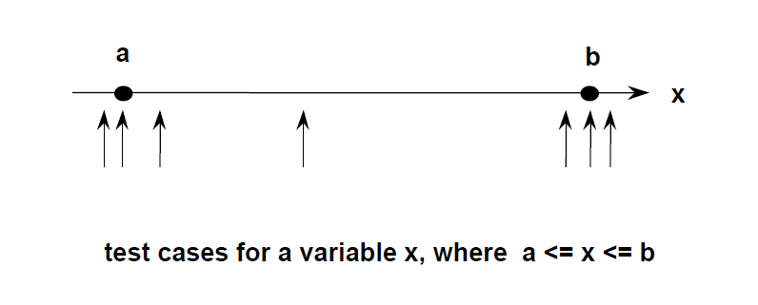
What is Boundary Value Analysis?
Method
• Hold all variables at their nominal value.
• Let one variable assume its boundary values.
• Repeat this for each variable.
• This will (hopefully) reveal all faults that can be attributed to a single variable.
Boundary value analysis works well when the program to be tested is a function of several independent variables that represent bounded physical quantities

Slide 4
Boundary Value Analysis : Generating Test Cases
Let’s consider a function of two variables, F(x1, x2)
For an n variable function this generates 4n + 1 test cases

Slide 5
Robustness Testing
For an n variable function this generates 6n + 1 test cases

Slide 6
Worst Case Testing
For an n variable function this generates 5^n test cases
More than one variable has a boundary condition tested

Slide 7
Robust Worst Case Testing
x
Robust Worst Case Test
2
Cases (function of two
variables)
d
c
a
b
x
1
For an n variable function this generates 7 ^ n test cases

Slide 8
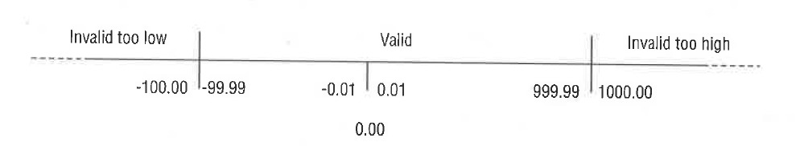
Determining Boundaries for Various Data Types : Guide Lines
Integer: One plus the max value and one less than the min values
Real: Depends on the decimal point values.
Character: Consider the ASCII sequence
Strings : consider the length or other character combination constrains. Sometimes, you may not be able to come up with one!

Slide 9
Boundary Value Analysis for the Triangle Problem
Triangle program accepts three integers a, b, and c as inputs. These are taken to be sides of a triangle. The output of the program is the type of triangle determined by the three sides: Equilateral, Isosceles, Scalene, or Not A Triangle. In addition 1 <= a <= 200, 1 <= b <= 200, and 1 <= c <= 200.
Also, to be a triangle sum of any two sides should be greater than the other side ( a < b +c , c < a + b, b < a +c ).

Slide 10
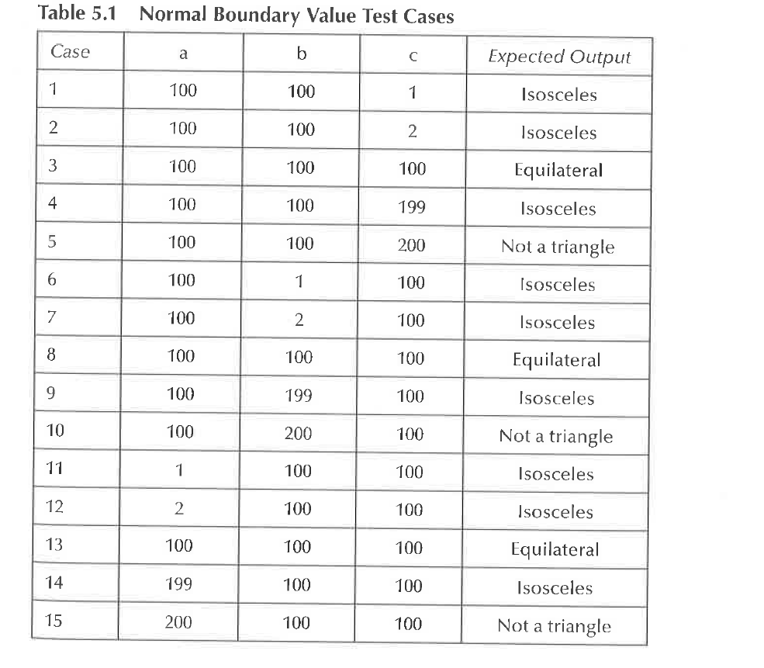
Boundary Value Based Test Cases for the Triangle Problem
Boundary conditions:
a={1 , 2, 100, 199, 200}
b={1 , 2, 100, 199, 200}
b={1 , 2, 100, 199, 200}
Read book section 5.5.1 (4th edition)

Slide 12
Next Time
Compare and contrast boundary value analysis and equivalent partition techniques
Limitations of equivalent partitions and boundary value analysis
Decision table based functional testing

